Slide 1

Project eCommerce
ZEYNAB AKOLADE

Slide 2
Project Flow Structure 1. Create all the tables with the accommodating data types according to the data available 2. Import csv.files into the tables
Retrieve sample data
Explore unique values with DISTINCT function
View the value
Identify missing and extreme values like the city & country

Slide 3
QA Process QA Process used to check for the completeness, uniqueness and consistency of the data. To check for the completeness, I used the COUNT in my query to confirm if there is any missing data from the entire data and which column has a NULL value. I used DISTINCT function to further drill down to the unique values in the data. For the consistency I ran a corrected query on for date and time columns where the initial data was presented as an integer and not a datetime function.
Data profiling
Data redundancy
Entity relationship
Data types formatting
Aggregations
Trend analysis
Data accuracy
Data Completeness

Slide 4
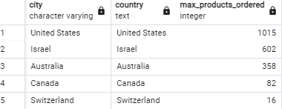
Top 5 city & country with rev transaction

Slide 5
Discovery from the data Even though I know there was a fact table is could not link the primary key as a unique identifier Too many missing values and columns
To answer the questions attached to the data I used sql query for all
Replace missing values where necessary
Used some aggregate functions in my query to drill down to the required logical result
And confirm results generated for accuracy

Slide 6
What more to do if there was time 1. Table normalization for better data cleaning 2. Data types detailing 3. Creating more tables 4. Connecting the primary and foreign keys after normalizing the tables to show clearer Entity Relationships
Thank you.

